Slide 1
Introduction to Web programming
0731213

Slide 2
Lecture 1 Styling HTML with CSS

Slide 3
Styling HTML with CSS
CSS stands for Cascading Style Sheets.
CSS describes how HTML elements are to be displayed on screen, paper, or in other media.
CSS saves a lot of work. It can control the layout of multiple web pages all at once.
The most common way to add CSS, is to keep the styles in separate CSS files.

Slide 4
CSS Advantages
Makes website more flexible
CSS is reusable
Change stylesheet to change design of many pages
Example: CSS Zen garden http://www.csszengarden.com/
Easier to maintain
Cleaner HTML code
Separates styles from HTML tags and page content
Consistent look across entire website that is easily maintained by changing styles in one place.

Slide 5
CSS Disadvantages
Not uniformly supported by all browsers.
CSS works differently on different browsers. IE and Opera supports CSS as different logic.
Chrome adheres to CSS standards more than IE
For this course we use Chrome

Slide 6
adding style
There are two aspects to adding style to a Web page via CSS
Specifying what the style looks like “Declaration”
Naming the HTML element “Selector”
selector
{
property: value;
property: value;
...
property: value;
} CSS
A CSS Selector
A CSS declaration
p {
font-family: sans-serif;
color: red;
} CSS

Slide 7
Naming HTML elements
There are two naming options for an HTML element:
assigning “ID” names
and “class names.”
An id declaration is the same as a class declaration, except that it should only be used specifically once per Web page.
<h1 class=”myboldandbluelook”> Introduction </h1>
.myboldandbluelook
{
font-weight: bold;
color: blue;
}
<h1 id=”myboldandbluelook”> Introduction </h1>
#myboldandbluelook
{
font-weight: bold;
color: blue;
}

Slide 8
Attaching a CSS file: <link>
How do I attach a CSS file to HTML?
CSS can be added to HTML documents in 3 ways:
Inline - by using the style attribute inside HTML elements.
Internal - by using a <style> element in the <head> section.
External - by using a <link> element to link to an external CSS file.
<head>
...
<link href="filename" type="text/css" rel="stylesheet" />
...
</head> HTML
<link href="style.css" type="text/css" rel="stylesheet" />
HTML
A page can link to multiple style sheet files
In case of a conflict (two sheets define a style for the same HTML element), the latter sheet's properties will be used
The rel attribute defines the relationship between the current page and the linked page. The rel="icon"

Slide 9
CSS properties for colors
p {
color: red;
background-color: yellow;
}
CSS
This paragraph uses the style above output
property | description
color | color of the element's text
background-color | color that will appear behind the element

Slide 10
Specifying colors
p { color: red; }
h2 { color: rgb(128, 0, 196); }
h4 { color: #FF8800; } CSS
This paragraph uses the first style above
This h2 uses the second style above.
This h4 uses the third style above.
output
color names: aqua, black, blue, fuchsia, gray, green, lime, maroon, navy, olive, purple, red, silver, teal, white (white), yellow
RGB codes: red, green, and blue values from 0 (none) to 255 (full)
hex codes: RGB values in base-16 from 00 (0, none) to FF (255, full) /// hexadecimal numbers
Hex values are actually just a different way to represent RGB values. Instead of using three numbers between 0 and 255, you use six hexadecimal numbers.

Slide 11
Lecture 2 CSS properties (1)

Slide 12
CSS properties for fonts
property | description
font-family | which font will be used
font-size | how large the letters will be drawn
font-style | used to enable/disable italic style
font-weight | used to enable/disable bold style
Complete list of font properties (https://www.w3schools.com/css/css_font.asp)

Slide 13
font-family
p {
font-family: Georgia;
}
h2 {
font-family: "Courier New";
} CSS
This paragraph uses the first style above.
This h2 uses the second style above.
output
Enclose multi-word font names in quotes

Slide 14
font-size
p {
font-size: 24pt;
} CSS
This paragraph uses the style above. output
units: pixels (px) vs. point (pt) vs. m-size (em)
16px, 16pt, 1.16em
vague font sizes: xx-small, x-small, small, medium, large, x-large, xx-large, smaller, larger
percentage font sizes, e.g.: 90%, 120%

Slide 15
font-size
p {
font-size: 24pt;
} CSS
This paragraph uses the style above. output
pt specifies number of point, where a point is 1/72 of an inch onscreen
px specifies a number of pixels on the screen
em specifies number of m-widths, where 1 em is equal to the font's current size

Slide 16
font-weight, font-style
p {
font-weight: bold;
font-style: italic;
} CSS
This paragraph uses the style above. output
Either of the above can be set to normal to turn them off (e.g. headings)

Slide 17
CSS properties for text
property | description
text-align | alignment of text within its element
text-decoration | decorations such as underlining
Complete list of text properties (https://www.w3schools.com/css/css_text.asp)

Slide 18
text-align
blockquote { text-align: justify; }
h2 { text-align: center; } CSS
The Gollum’s Quote
We wants it, we needs it. Must have the precious. They stole it from us. Sneaky little hobbitses. Wicked, tricksy, false! output
text-align can be left, right, center, or justify
justify (which widens all full lines of the element so that they occupy its entire width)

Slide 19
text-decoration
p {
text-decoration: underline;
} CSS
This paragraph uses the style above. output
can also be overline, line-through, blink, or none
effects can be combined:
text-decoration: overline underline;

Slide 20
CSS properties for Layout
The float Property
The float property is used for positioning and layout on web pages.
The float property can have one of the following values:
left - The element floats to the left of its container
right- The element floats to the right of its container
none - The element does not float (will be displayed just where it occurs in the text). This is default
inherit - The element inherits the float value of its parent
In its simplest use, the float property can be used to wrap text around images.

Slide 21
CSS properties for Layout
The float Property
Example - float: right;
The following example specifies that an image should float to the right in a text:
img { float: right; }

Slide 22
CSS properties for Layout
The float Property
Example - float: left;
The following example specifies that an image should float to the left in a text:
img { float: left; }

Slide 23
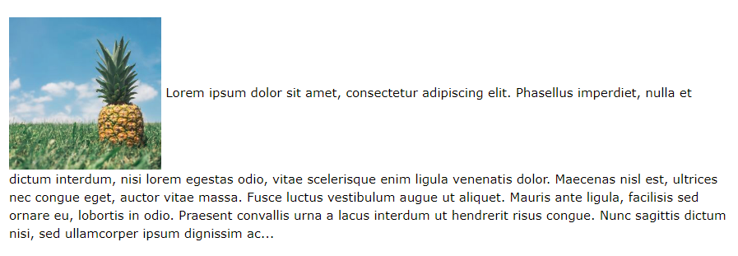
CSS properties for Layout
The float Property
Example - No float
In the following example the image will be displayed just where it occurs in the text (float: none;):
img { float: none; }

Slide 24
CSS properties for Layout
The clear Property
The clear property specifies what elements can float beside the cleared element and on which side.
The clear property can have one of the following values:
none - Allows floating elements on both sides. This is default
left - No floating elements allowed on the left side
right- No floating elements allowed on the right side
both - No floating elements allowed on either the left or the right side
inherit - The element inherits the clear value of its parent
The CSS float property specifies how an element should float. The CSS clear property specifies what elements can float beside the cleared element and on which side.
The most common way to use the clear property is after you have used a float property on an element.
When clearing floats, you should match the clear to the float. If an element is floated to the left, then you should clear to the left. Your floated element will continue to float, but the cleared element will appear below it on the web page.

Slide 25
CSS properties for Layout
The clear Property
The following example clears the float to the left. Means that no floating elements are allowed on the left side (of the div):
div { clear: left; }
Without Clear
With Clear

Slide 26
Lecture 3 CSS properties (2)

Slide 27
CSS properties
CSS properties for colors. More details
CSS properties for Backgrounds. More details
CSS properties for Borders. More details
CSS properties for Margins. More details
CSS properties for padding. More details
CSS properties for text. More details
CSS properties for fonts. More details
CSS properties for links. More details
CSS properties for float and clear. More details
CSS properties for align. More details
and even more

Slide 28
Body styles
body {
font-size: 16px;
} CSS
Applies a style to the entire body of your page
Saves you from manually applying a style to each element

Slide 29
CSS comments /*…*/
/* This is a comment.
It can span many lines in the CSS file. */
p {
color: red; background-color: aqua;
} CSS
The // single-line comment style is NOT supported in CSS
The <!-- ... --> HTML comment style is also NOT supported in CSS

Slide 30
Grouping styles
p, h1, h2 {
color: green;
}
h2 {
background-color: yellow;
} CSS
This paragraph uses the above style.
output
This h2 uses the above styles.
A style can select multiple elements separated by commas
The individual elements can also have their own styles

Slide 31
Descendant (nested) selector
Syntax is similar to the example of grouping selectors—but without the commas
Selects all elements that correspond to the “nested” structure specified by the selector
E.g., the above style will apply to any <strong> HTML tag that lies within an <a> tag that lies within an <li> tag that lies within a <ul> tag
ul li a strong{color:green;} CSS

Slide 32
CSS Example
Example.html style.css
HTML
CSS

Slide 33
References
https://www.w3schools.com/
Robin Nixon, Learning PHP, MySQL, JavaScript, and CSS, 2013
Mike McGrath, PHP & My SQL in easy steps, 2012.

Slide 34
The End

